Slide 1

Applications Development Practice 3 (ADP372S)
Lecturer: Kruben Naidoo
Email: NaidooK@cput.ac.za
Office: Rm 2.11 – Engineering Building, District Six Campus, Cape Town, South Africa.

Slide 2
Lesson objectives:
Recap
The Strategy Design Pattern
The Adapter Design Pattern
The Observer Design Pattern
Summary
LinkedIn Learning video on Design Principles

Slide 3
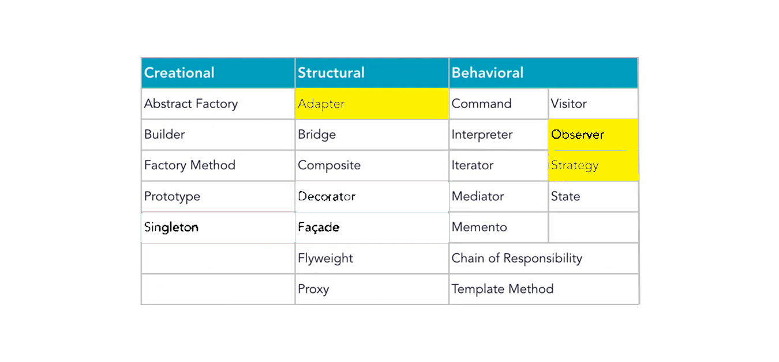
Figure: 23 Gang of Four (GOF) Patterns

Slide 4
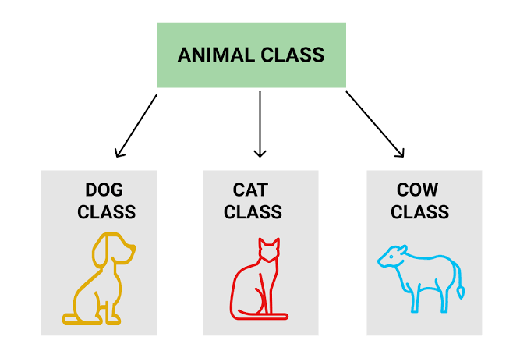
Revisiting Inheritance
When you over-use inheritance you end up with designs that are inflexible and difficult to change.

Slide 5
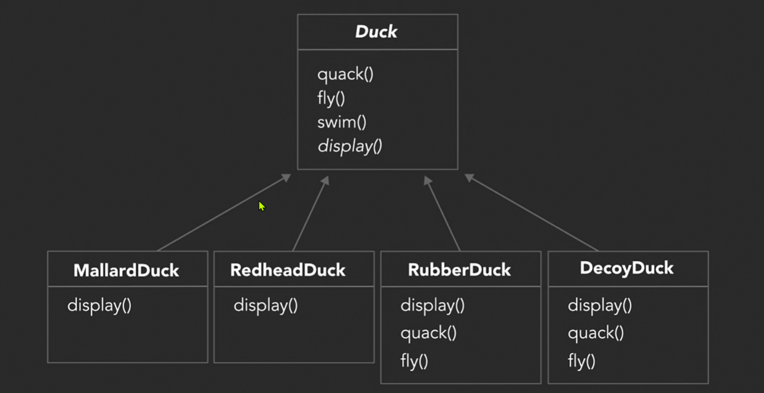
Limitations of Inheritance

Slide 6
Limitations of Inheritance
Flying and quacking get no benefits from inheritance for some ducks
We have code duplicated across classes – code to keep from flying and quacking
Its hard to gain knowledge about the ducks from just the superclass (we have to drill into the subclasses)
Changes in the superclass can lead to unintended behaviour in the other classes
Runtime behaviour changes are difficult for example, to no be able to fly if the duck is injured or captured.

Slide 7
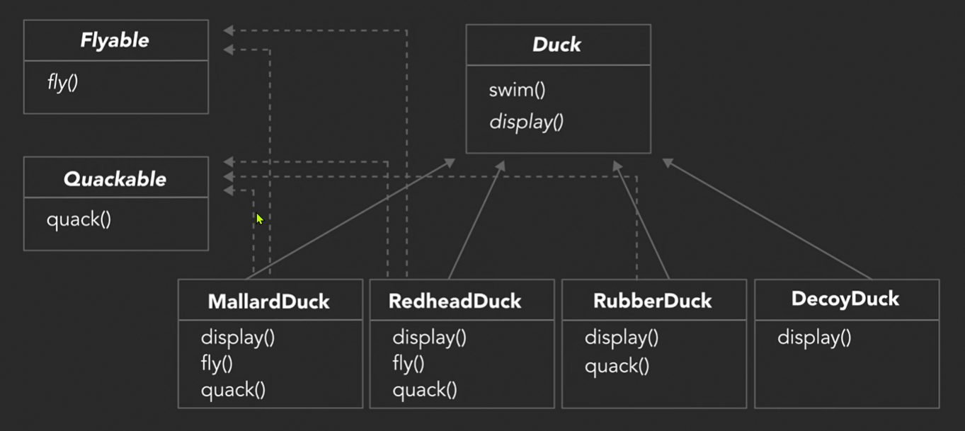
Trying interfaces

Slide 8
Problems with the design
It destroys code reuse
It becomes a maintenance nightmare
It doesn’t allow for runtime changes in behaviours (for example, if we wanted a duck to start life not being able to fly and acquire the ability to fly midway through the simulation.

Slide 9
Get inspiration from design principles
Inheritance didn’t work well
Behaviour changes across subclasses, and its not possible for all subclasses to have all behaviours
Interfaces didn’t work well
They sound promising, but interfaces supply no implementation and destroy code reuse.
Encapsulate what varies
Identify the aspects of your application that vary and separate them from what stays the same.
Program to an interface, not an implementation

Slide 10
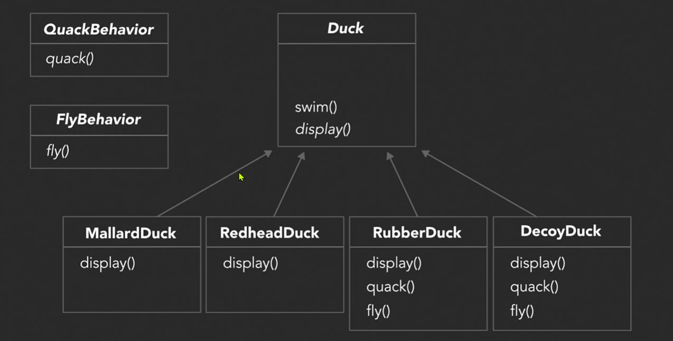
Programming to an interface

Slide 11
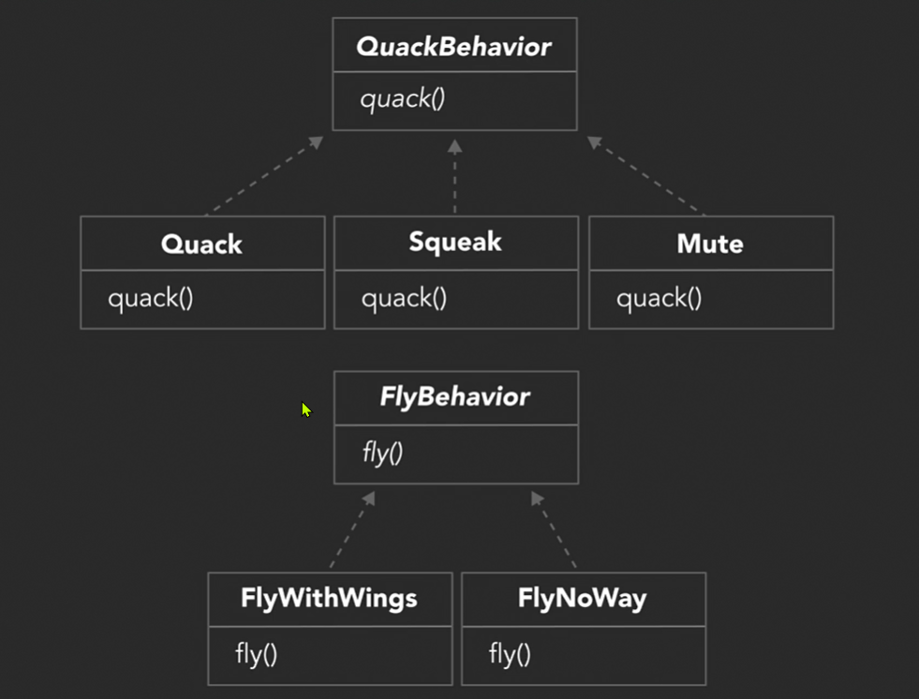
Programming to an interface contd.

Slide 12
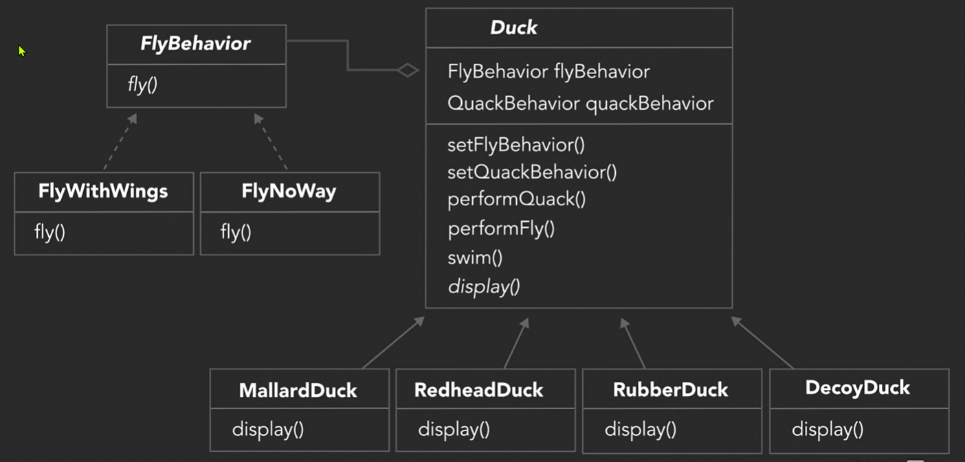
Programming to an interface contd.

Slide 13
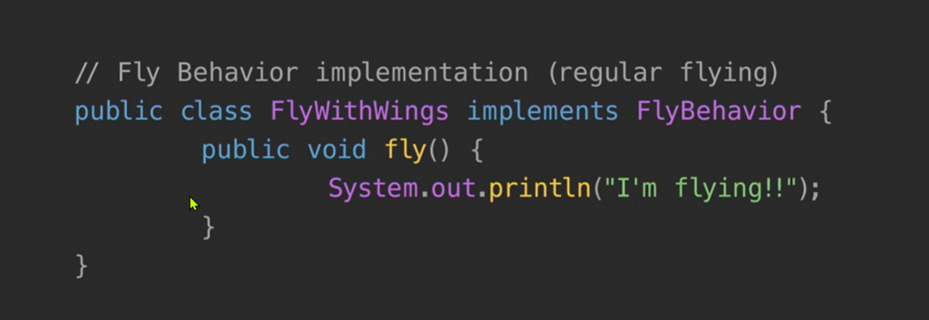
Applying the principles

Slide 14
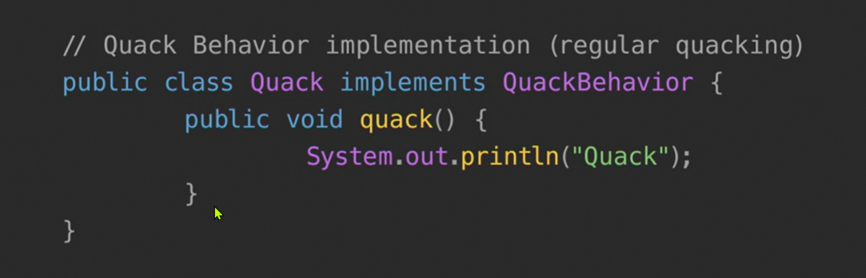
Applying the principles contd.

Slide 15
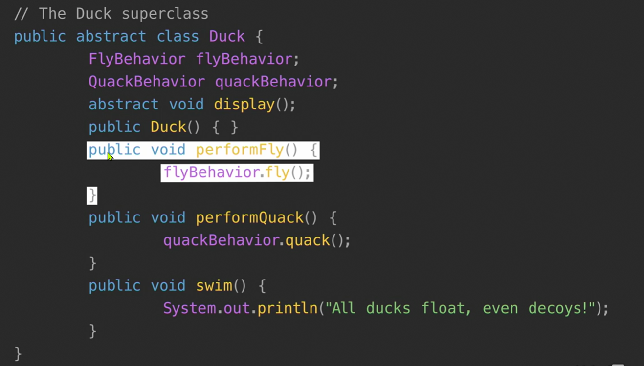
Applying the principles contd.

Slide 16
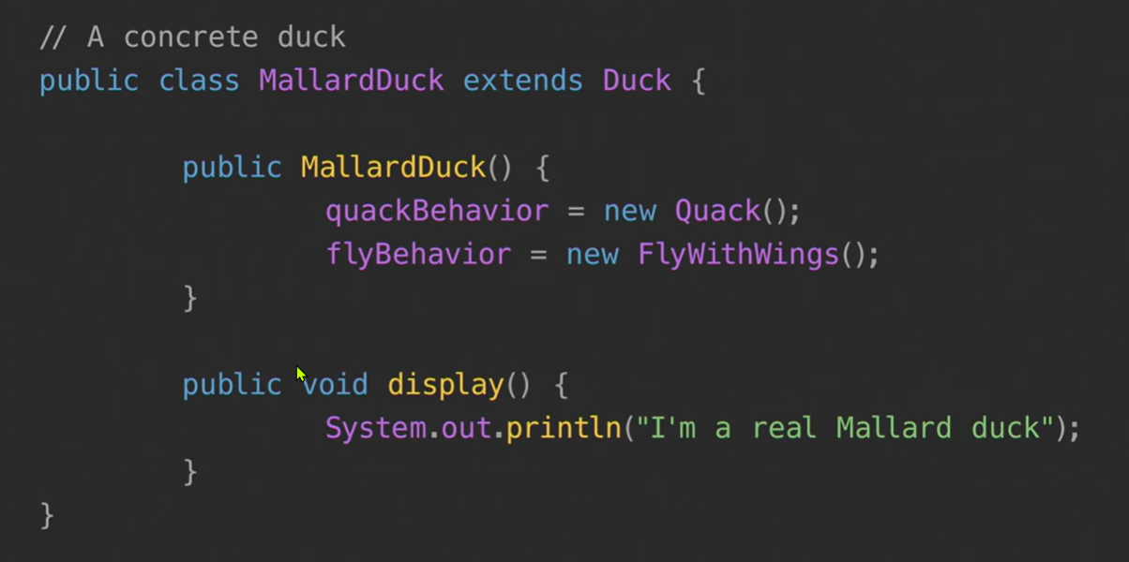
Applying the principles contd.

Slide 17
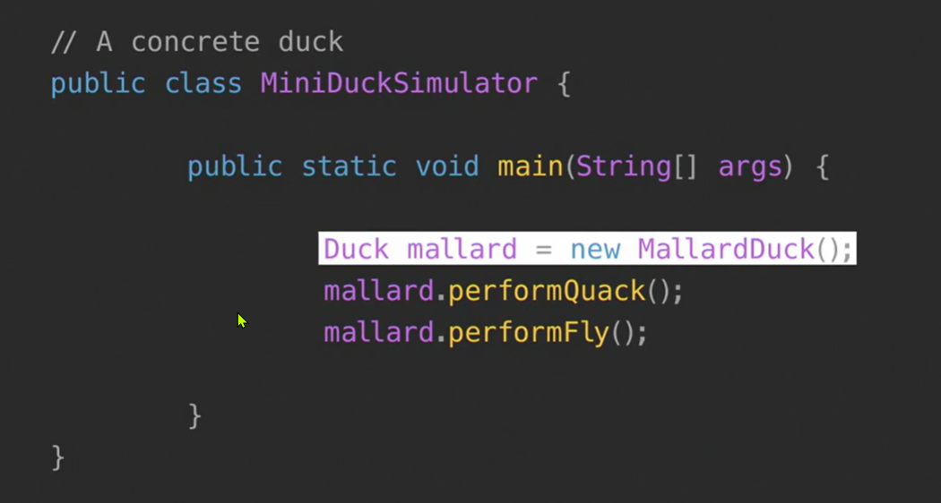
Applying the principles contd.

Slide 18
Exploring the strategy pattern

Slide 19
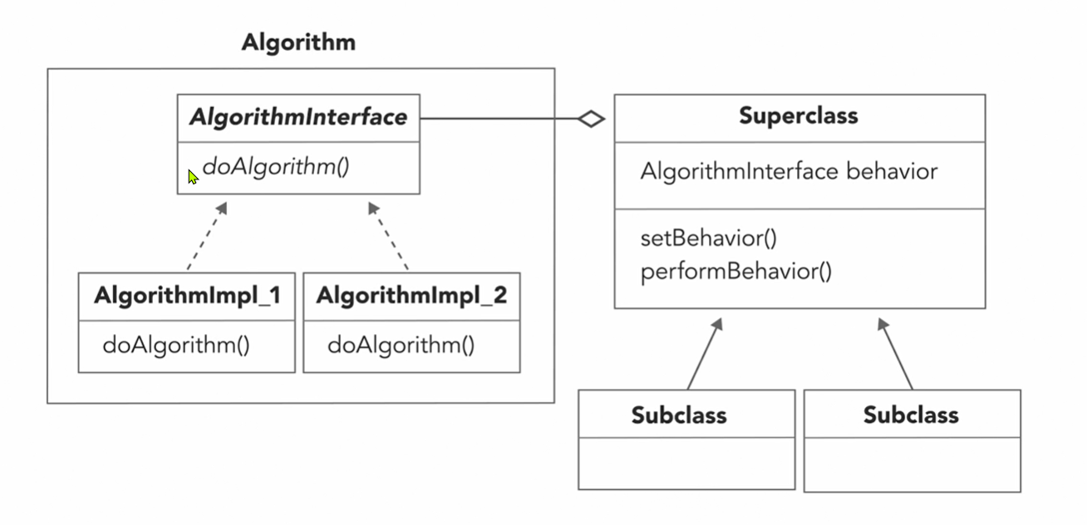
The strategy pattern class diagram

Slide 20
The strategy pattern official definition
This pattern defines a family of algorithms, encapsulates each one, and makes them interchangeable. This lets the algorithm vary independently from clients that use it.
Now this definition doesn’t tell us how to implement the pattern, but it does give us a good idea of the intent of a pattern. You have seen how we implemented the pattern in the duck simulator and how that design allowed our ducks to be more flexible and made the overall system more resilient to change.

Slide 21
Why HAS-A is better than IS-A
We’re using a HAS-A relationship
Each duck has a FlyBehaviour and a QuackBehaviour
Instead of inheriting behaviour, we’re composing it
A duck is composed with fly behaviour and a quack behaviour
Favour Composition over Inheritance
Classes should achieve code reuse using composition rather than inheritance from a superclass.

Slide 22
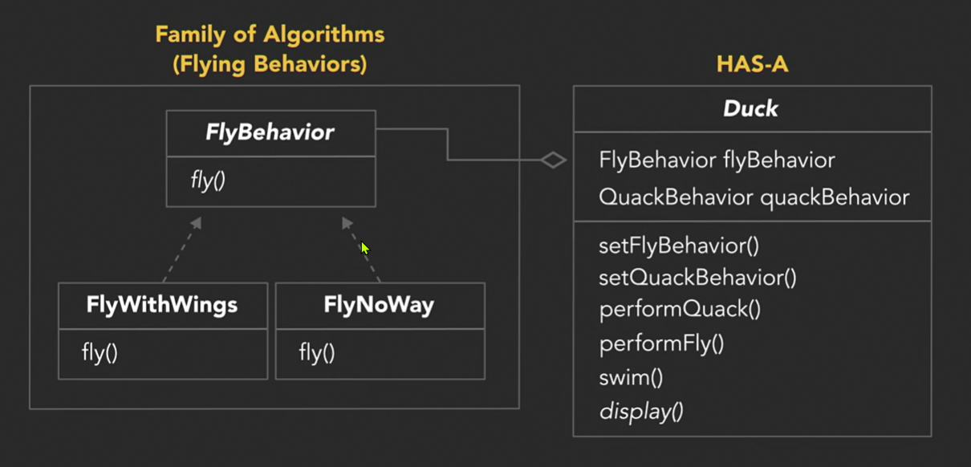
Why HAS-A is better than IS-A

Slide 23
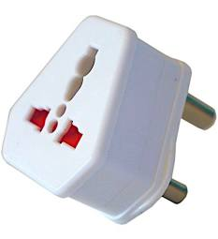
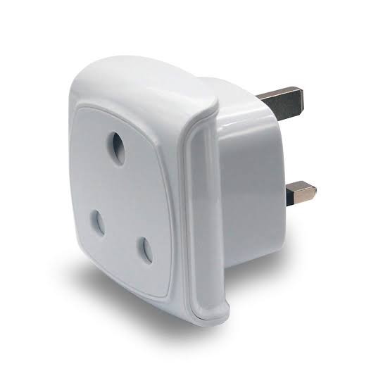
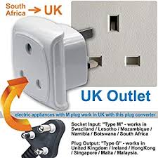
Understanding the adapter pattern
Lets suppose you decide to travel to Dubai, and need to charge your Android/iPhone. Unfortunately, your RSA charger plug/connector wont fit in the wall socket in your hotel. The interfaces are different. You’re going to need an adapter…

Slide 24
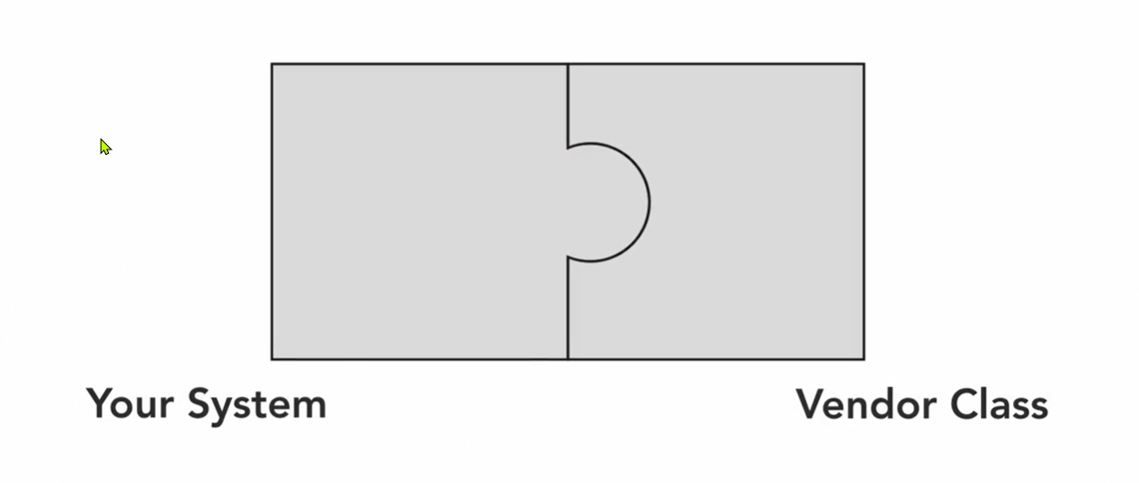
Understanding the adapter pattern
Let’s look at a more IT related example:

Slide 25
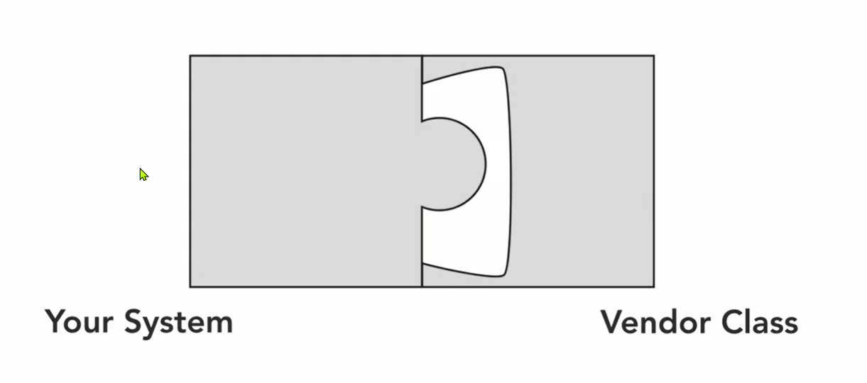
Understanding the adapter pattern
Let’s look at a more IT related example:

Slide 26
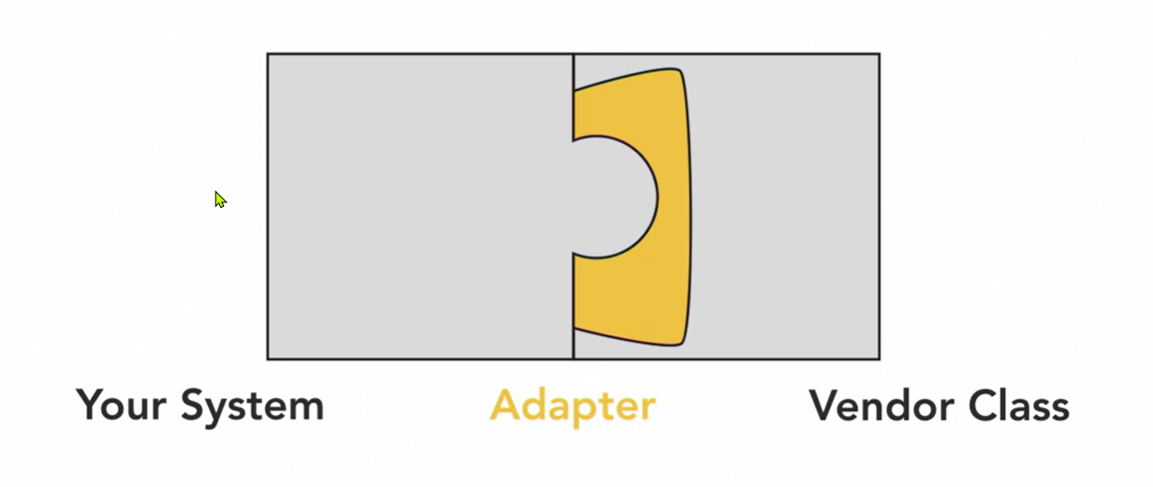
Understanding the adapter pattern
Let’s look at a more IT related example:

Slide 27
The Adapter pattern defined
This pattern converts the interface of a class into another interface that a clients expect. It allows classes to work together that couldn’t otherwise because of incompatible interfaces.

Slide 28
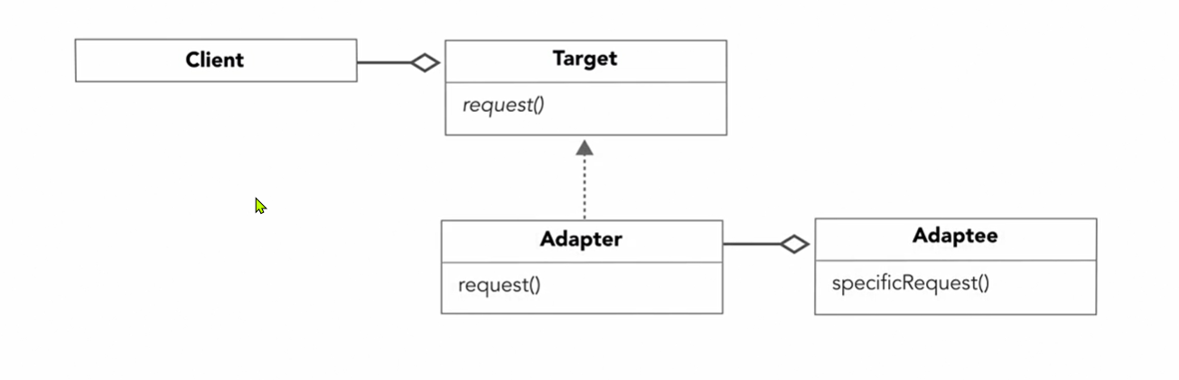
The Adapter pattern class diagram

Slide 29
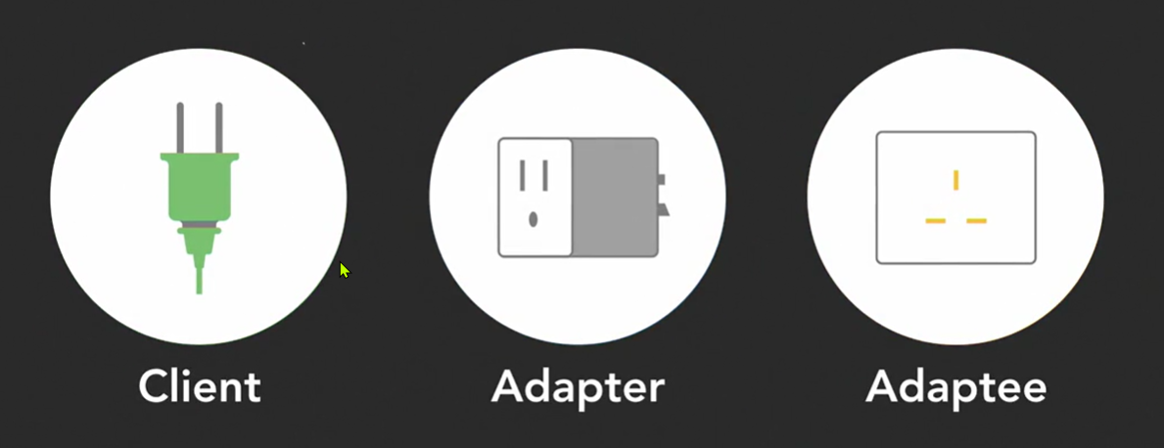
Using the adapter pattern

Slide 30
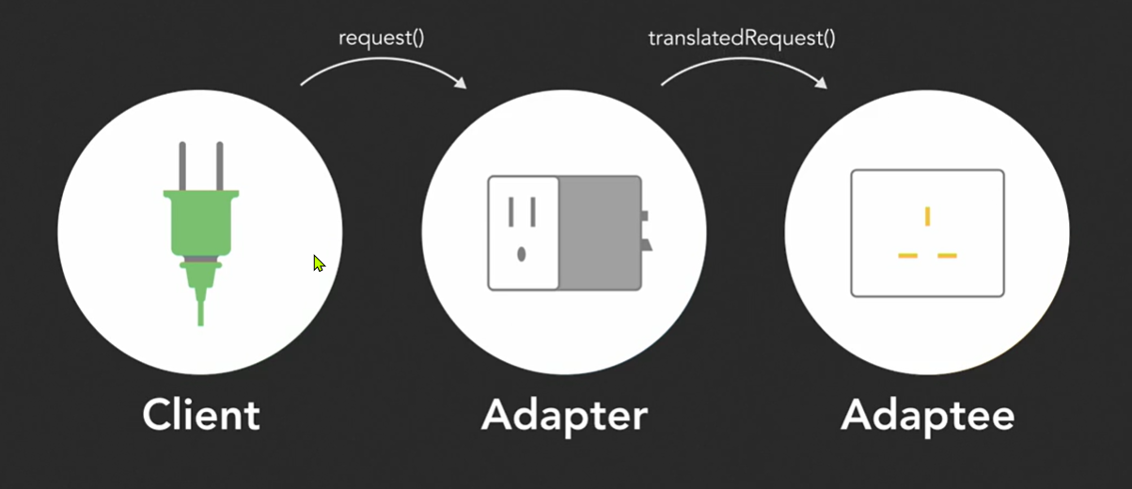
Using the adapter pattern

Slide 31
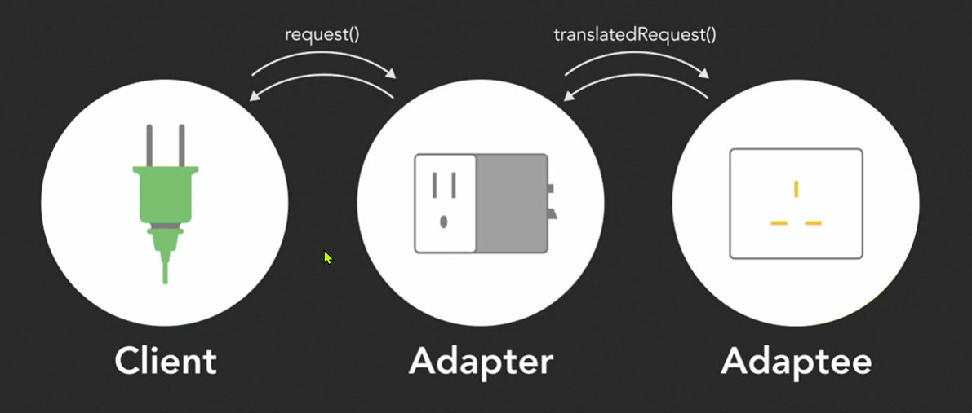
Using the adapter pattern

Slide 32
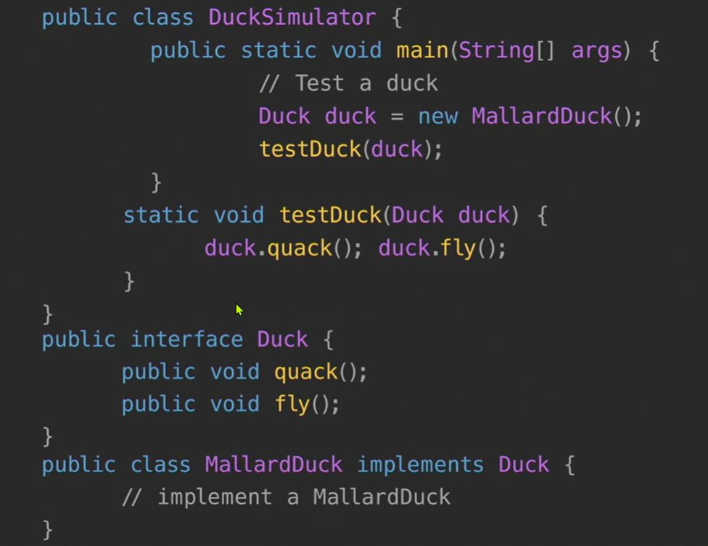
Using the adapter pattern

Slide 33
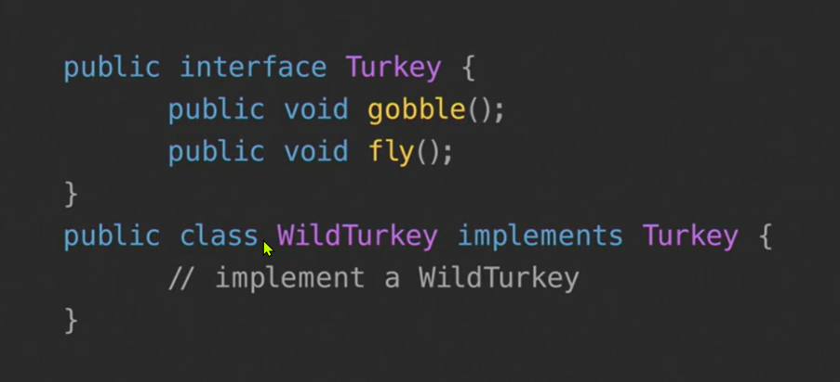
Using the adapter pattern

Slide 34
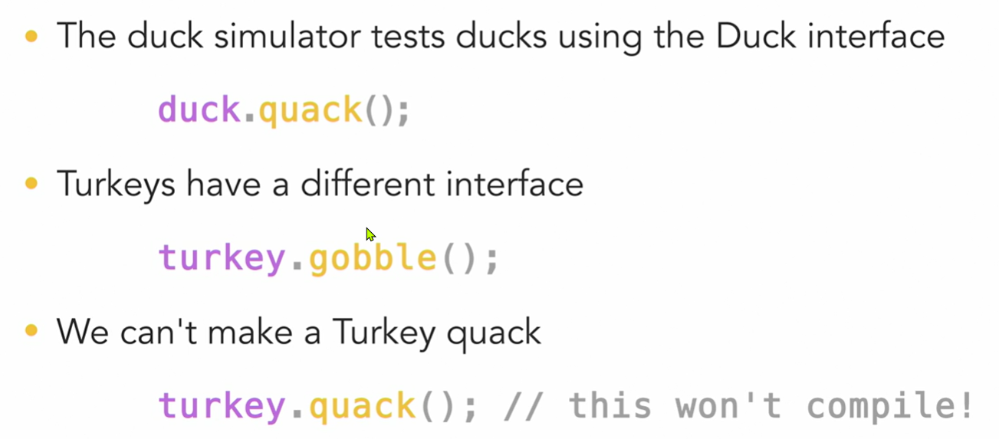
Using Turkeys with the Duck Simulator

Slide 35
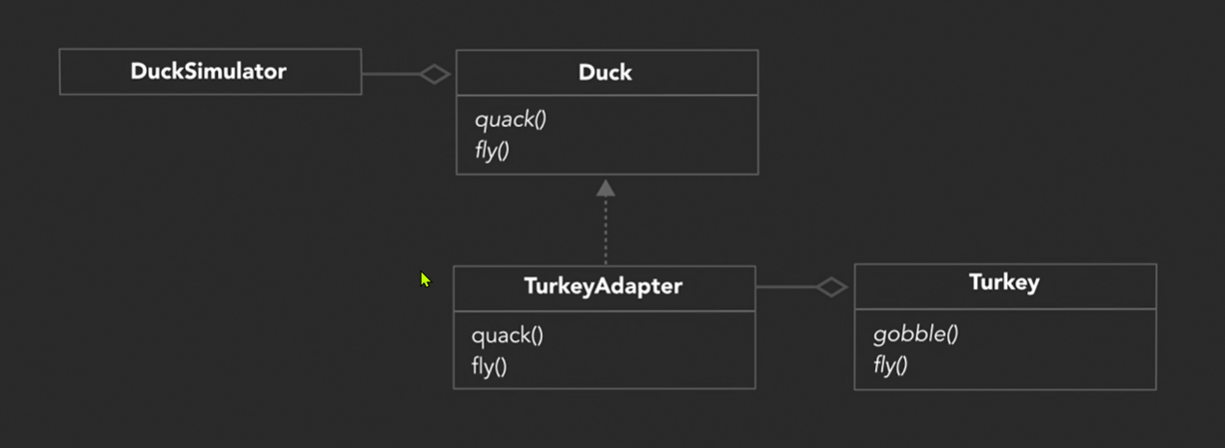
Making a TurkeyAdapter

Slide 36
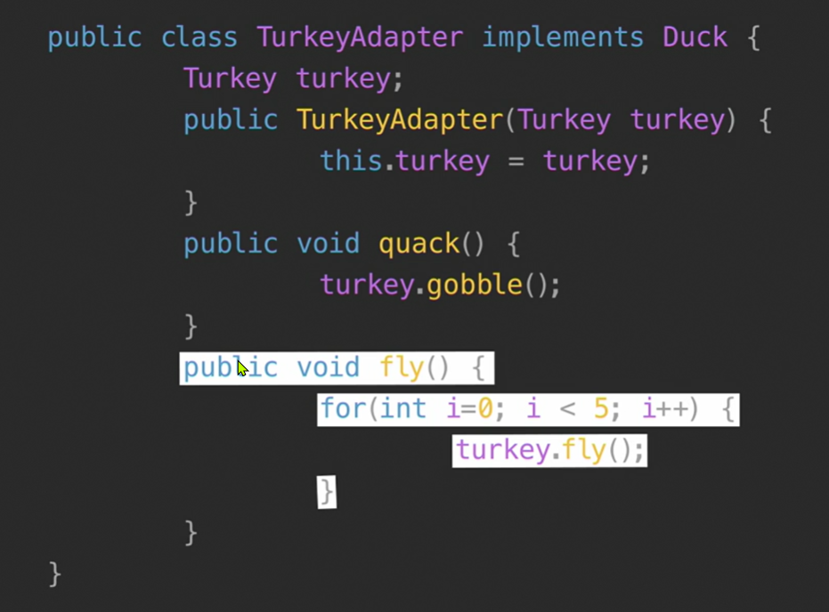
Using Turkeys with the Duck Simulator

Slide 37
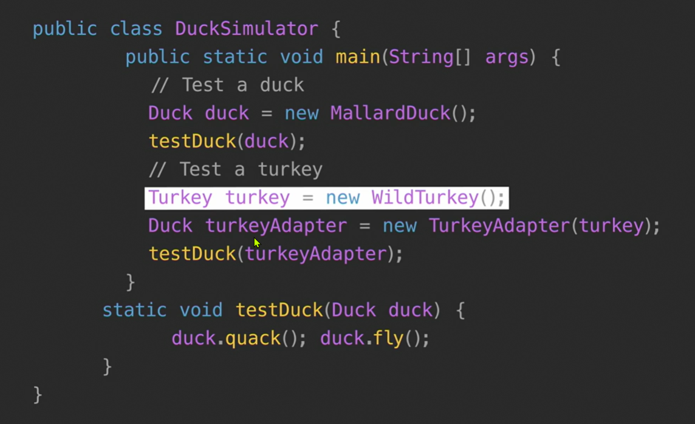
Using Turkeys with the Duck Simulator

Slide 38
Adapters using Composition
The client is composed with the class with the client interface
The adapter is composed with the adaptee
The adapter delegates calls to the adaptee, and returns any needed value
The client and the adaptee don’t know there’s an adapter in between

Slide 39
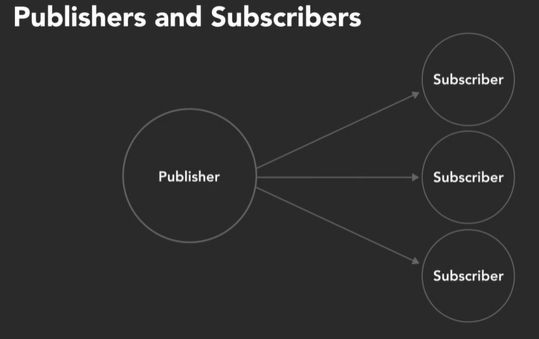
Understanding the observer pattern
Loosely Coupling
Strive for loosely coupled designs between objects that interact
An example,

Slide 40
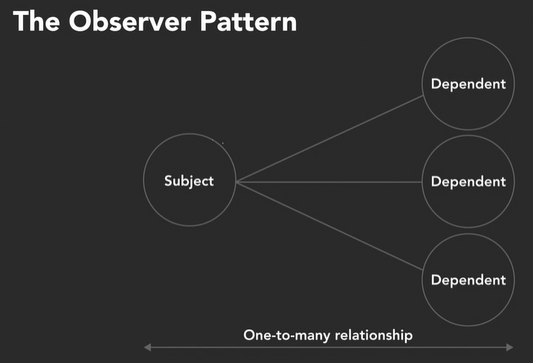
The Observer pattern defined
The pattern defines a one-to-many dependency between objects so that when one object changes state, all of its dependents are notified and updated automatically.

Slide 41
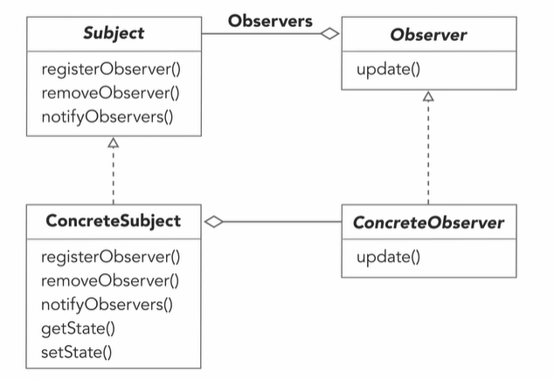
The Observer pattern class diagram

Slide 42
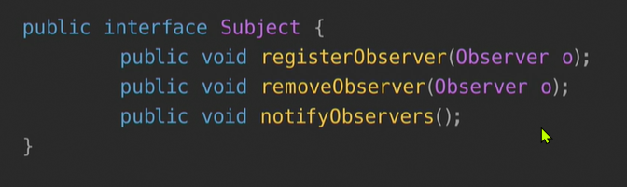
Using the Observer pattern

Slide 43
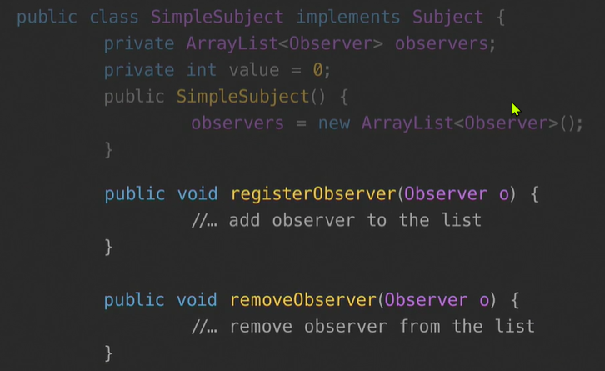
Using the Observer pattern

Slide 44
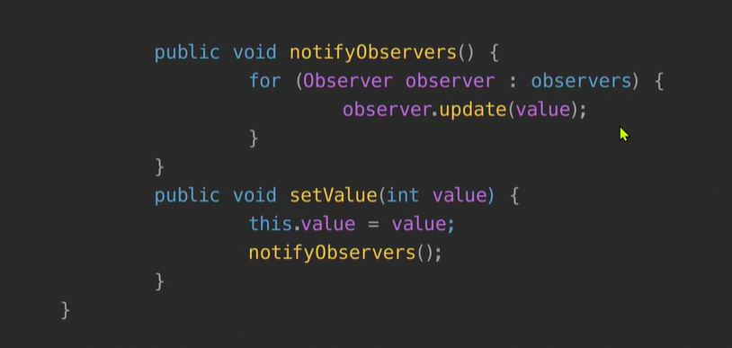
Using the Observer pattern

Slide 45
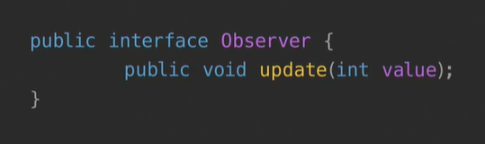
Using the Observer pattern

Slide 46
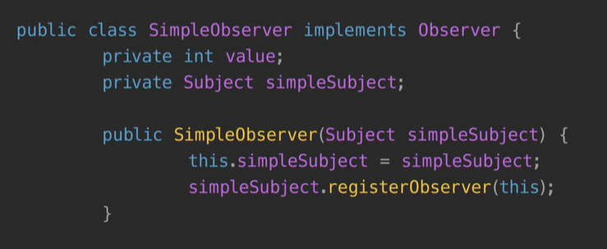
Using the Observer pattern

Slide 47
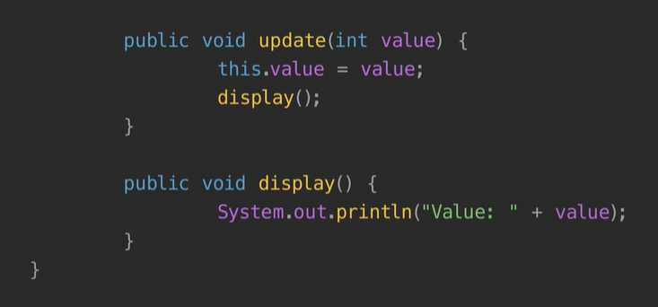
Using the Observer pattern

Slide 48
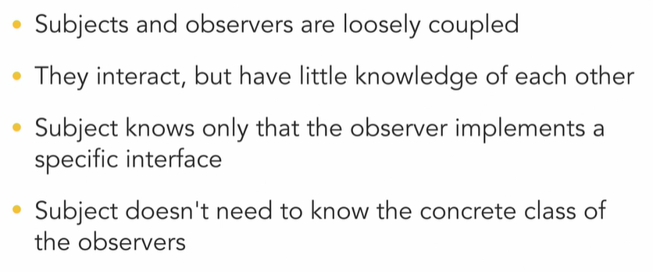
The Observer pattern and loose coupling

Slide 49
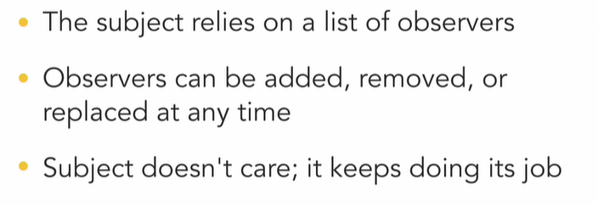
The Observer pattern and loose coupling

Slide 50
Any questions?

